Slide 1
The Field Effect Transistor (FET)
In 1945, Shockley had an idea for making a solid state device out of semiconductors.
He reasoned that a strong electrical field could cause the flow of electricity within a nearby semiconductor.
He tried to build one, but it didn't work.
Three years later, Brattain & Bardeen built the first working transistor, the germanium point-contact transistor, which was designed as the junction (sandwich) transistor.
In 1960 Bell scientist John Atalla developed a new design based on Shockley's original field-effect theories.
By the late 1960s, manufacturers converted from junction type integrated circuits to field effect devices.

Slide 2
The Field Effect Transistor (FET)
Field effect devices are those in which current is controlled by the action of an electron field, rather than carrier injection.
Field-effect transistors are so named because a weak electrical signal coming in through one electrode creates an electrical field through the rest of the transistor.
The FET was known as a “unipolar” transistor.
The term refers to the fact that current is transported by carriers of one polarity (majority), whereas in the conventional bipolar transistor carriers of both polarities (majority and minority) are involved.

Slide 3
The Field Effect Transistor (FET)
The family of FET devices may be divided into :
Junction FET
Depletion Mode MOSFET
Enhancement Mode MOSFET

Slide 4
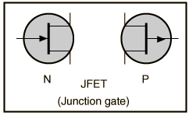
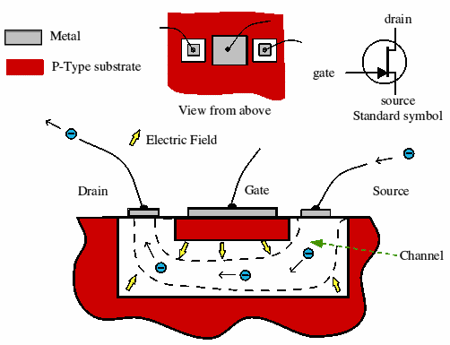
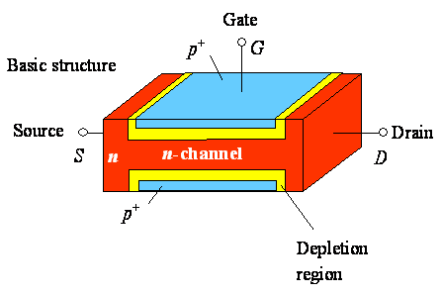
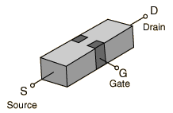
Junction FETs (JFETs)
JFETs consists of a piece of high-resistivity semiconductor material (usually Si) which constitutes a channel for the majority carrier flow.
Conducting semiconductor channel between two ohmic contacts – source & drain

Slide 5
Junction FETs (JFETs)
The magnitude of this current is controlled by a voltage applied to a gate, which is a reverse-biased.
The fundamental difference between JFET and BJT devices: when the JFET junction is reverse-biased the gate current is practically zero, whereas the base current of the BJT is always some value greater than zero.

Slide 6
Junction FETs
JFET is a high-input resistance device, while the BJT is comparatively low.
If the channel is doped with a donor impurity, n-type material is formed and the channel current will consist of electrons.
If the channel is doped with an acceptor impurity, p-type material will be formed and the channel current will consist of holes.
N-channel devices have greater conductivity than p-channel types, since electrons have higher mobility than do holes; thus n-channel JFETs are approximately twice as efficient conductors compared to their p-channel counterparts.

Slide 7
Basic structure of JFETs
In addition to the channel, a JFET contains two ohmic contacts: the source and the drain.
The JFET will conduct current equally well in either direction and the source and drain leads are usually interchangeable.

Slide 8
N-channel JFET
This transistor is made by forming a channel of N-type material in a P-type substrate.
Three wires are then connected to the device.
One at each end of the channel.
One connected to the substrate.
In a sense, the device is a bit like a PN-junction diode, except that there are two wires connected to the N-type side.

Slide 9
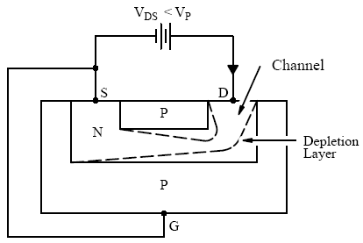
How JFET Function
The gate is connected to the source.
Since the pn junction is reverse-biased, little current will flow in the gate connection.
The potential gradient established will form a depletion layer, where almost all the electrons present in the n-type channel will be swept away.
The most depleted portion is in the high field between the G and the D, and the least-depleted area is between the G and the S.

Slide 10
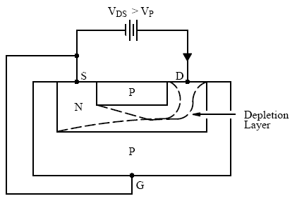
How JFET Function
Because the flow of current along the channel from the (+ve) drain to the (-ve) source is really a flow of free electrons from S to D in the n-type Si, the magnitude of this current will fall as more Si becomes depleted of free electrons.
There is a limit to the drain current (I_{D}) which increased V_{DS} can drive through the channel.
This limiting current is known as I_{DSS} (Drain-to-Source current with the gate shorted to the source).

Slide 11
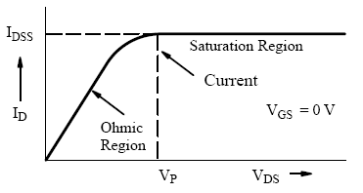
The output characteristics of an n-channel JFET with the gate short-circuited to the source.
The initial rise in I_{D} is related to the buildup of the depletion layer as V_{DS} increases.
The curve approaches the level of the limiting current I_{DSS} when I_{D} begins to be pinched off.
The physical meaning of this term leads to one definition of pinch-off voltage, V_{P} , which is the value of V_{DS} at which the maximum I_{DSS} flows.

Slide 12
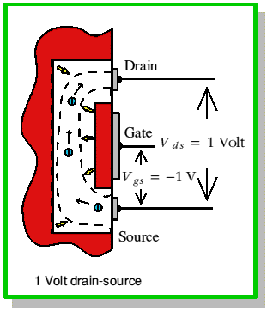
With a steady gate-source voltage of 1 V there is always 1 V across the wall of the channel at the source end.
A drain-source voltage of 1 V means that there will be 2 V across the wall at the drain end. (The drain is ‘up’ 1V from the source potential and the gate is 1V ‘down’, hence the total difference is 2V.)
The higher voltage difference at the drain end means that the electron channel is squeezed down a bit more at this end.

Slide 13
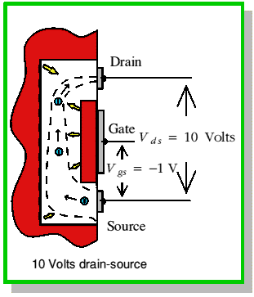
When the drain-source voltage is increased to 10V the voltage across the channel walls at the drain end increases to 11V, but remains just 1V at the source end.
The field across the walls near the drain end is now a lot larger than at the source end.
As a result the channel near the drain is squeezed down quite a lot.

Slide 14
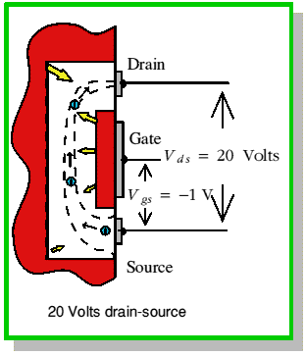
Increasing the source-drain voltage to 20V squeezes down this end of the channel still more.
As we increase this voltage we increase the electric field which drives electrons along the open part of the channel.
However, also squeezes down the channel near the drain end.
This reduction in the open channel width makes it harder for electrons to pass.
As a result the drain-source current tends to remain constant when we increase the drain-source voltage.

Slide 15
Increasing V_{DS} increases the widths of depletion layers, which penetrate more into channel and hence result in more channel narrowing toward the drain.
The resistance of the n-channel, R_{AB} therefore increases with V_{DS}.
The drain current: I_{DS} = V_{DS}/R_{AB}
I_{D} versus V_{DS} exhibits a sublinear behavior, see figure for V_{DS} < 5V.
The pinch-off voltage, V_{P} is the magnitude of reverse bias needed across the p⁺n junction to make them just touch at the drain end.
Since actual bias voltage across p⁺n junction at drain end is V_{GD}, the pinch-off occur whenever: V_{GD} = -V_{P}.

Slide 16
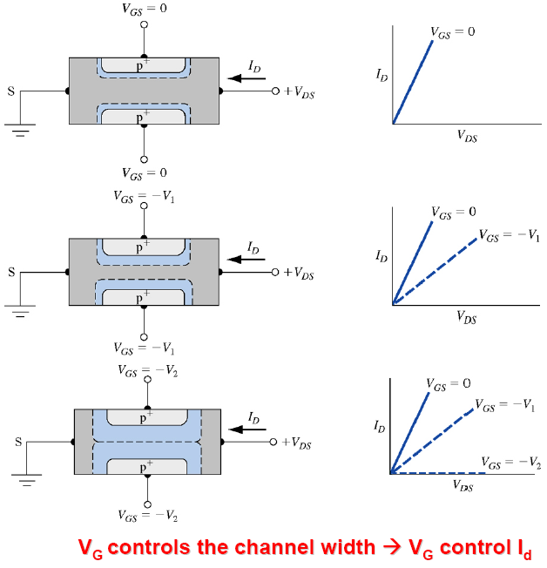
I-V characteristics

Slide 17
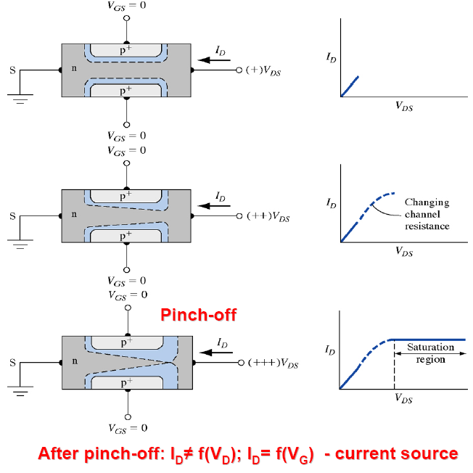
I-V characteristics

Slide 18
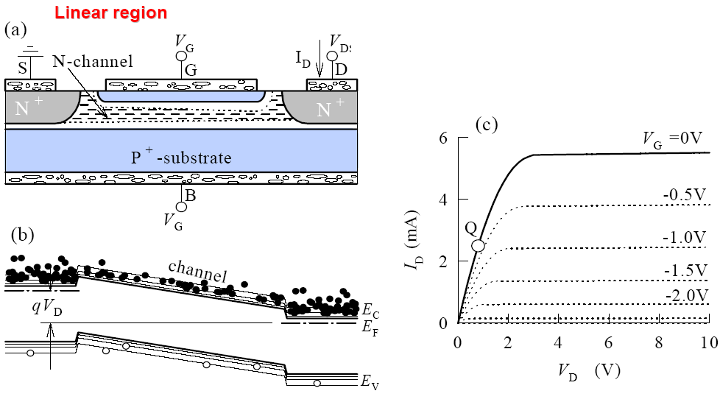
JFET: I-V characteristics

Slide 19
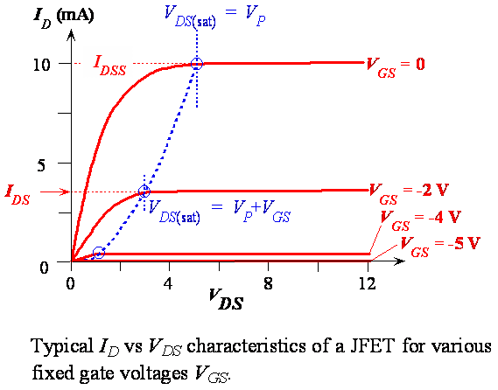

Slide 20
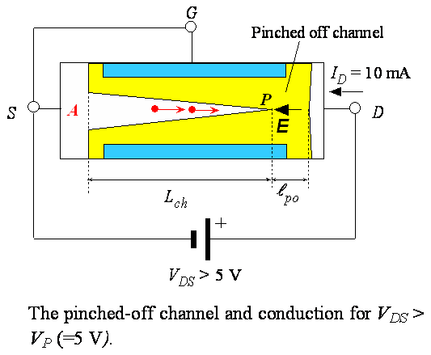
Beyond V_{DS} = V_{P}, there is a short pinch-off channel of length, ℓ_{po}.
As V_{DS} increases, most of additional voltage simply drops across ℓ_{po} as this region is depleted of carriers and hence highly resistive.
Voltage drop across channel length, L_{ch} remain as V_{P}.
Beyond pinch-off then I_{D} = V_{P}/R_{AP} (V_{DS}>V_{P}).

Slide 21
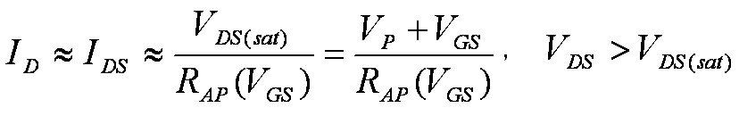
Beyond pinch-of, with –ve V_{GS}, I_{DS} is
Where R_{AP}(V_{GS}) is the effective resistance of the conducting n-channel from A to P, which depends on channel thickness and hence V_{GS}.
When V_{GS}= -V_{P}= -5V with V_{DS}= 0, the two depletion layers touch over the entire channel length and the whole channel is closed.
The channel said to be off.

Slide 22
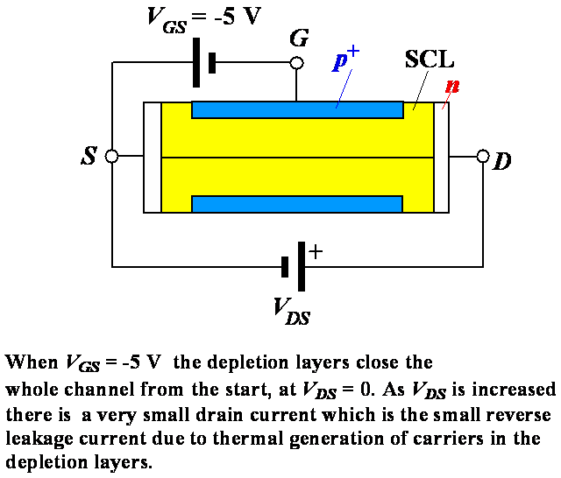

Slide 23
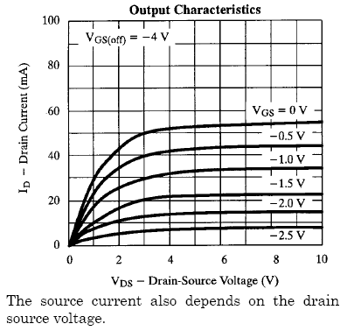
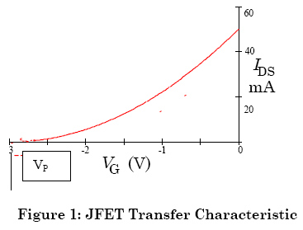
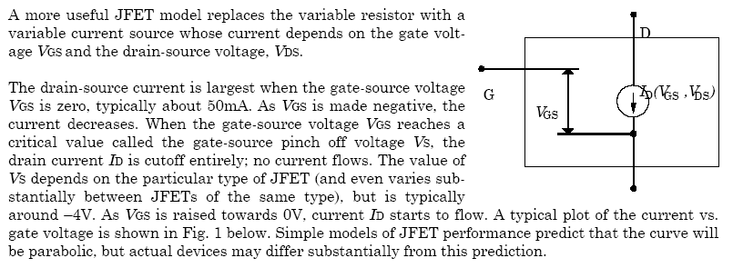

Slide 24
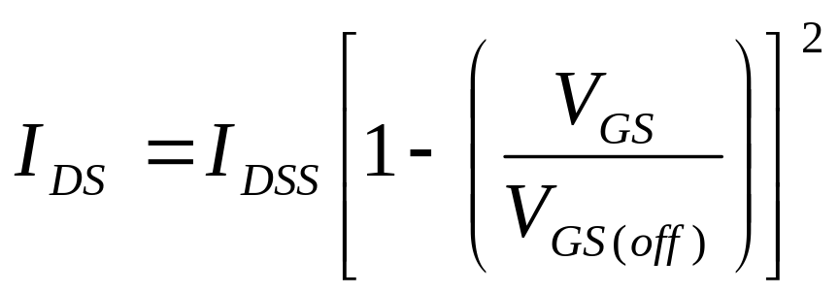
There is a convenient relationship between I_{DS} and V_{GS.}
Beyond pinch-off
Where I_{DSS} is drain current when V_{GS}= 0 and V_{GS(off)} is defined as –V_{P}, that is gate-source voltage that just pinches off the channel.
The pinch off voltage V_{P} here is a +ve quantity because it was introduced through V_{DS(sat)}.
V_{GS(off)} however is negative, -V_{P}.

Slide 25
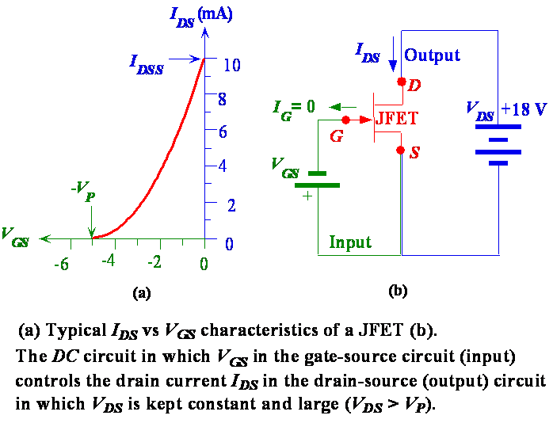

Slide 26
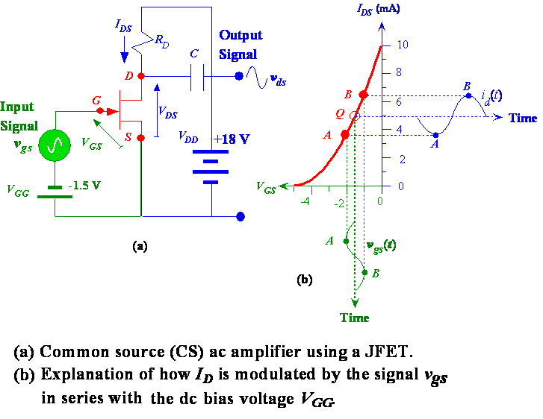

Slide 27
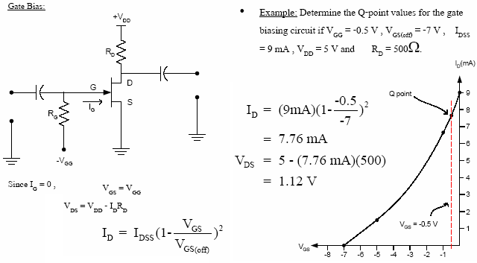
JFET Biasing Circuits

Slide 28
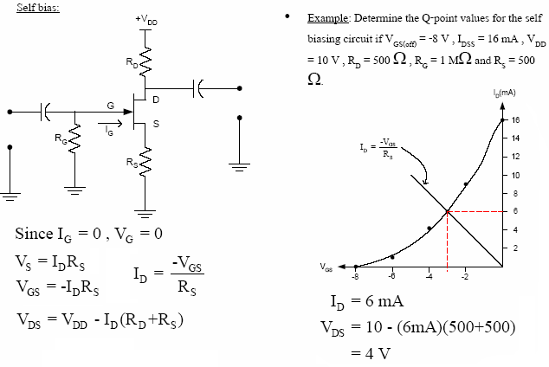

Slide 29
